Slide 1
Digital Portfolio
STUDENT NAME: Kathirvel.N
REGISTER NO : 2428K0338
NMID : 65021079D13421F9F6044664B69DE73A
DEPARTMENT : B.SC., CS(Artificial intelligence & Data Science)
COLLEGE : NIFT-TEA College of Knitwear Fashion,Tiruppur,
Bharathiyar University, Coimbatore.

Slide 2
PROJECT TITLE MY PORTFOLIO

Slide 3


AGENDA
Problem Statement
Project Overview
End Users
Tools and Technologies
Portfolio design and Layout
Features and Functionality
Results and Screenshots
Conclusion
Github Link

Slide 4

PROBLEM STATEMENT
In today’s competitive environment, students and fresh graduates face challenges in effectively presenting their skills, achievements, and projects to recruiters, faculty, and industry professionals. Traditional resumes often fail to capture a person’s full potential, creativity, and technical knowledge. Moreover, recruiters prefer quick and visually engaging platforms to evaluate candidates rather than lengthy documents. Without a professional portfolio, there is a gap in communication between the student’s abilities and the recruiter’s expectations. Therefore, there is a need for a personal portfolio website that provides a structured, accessible, and attractive way to showcase an individual’s education, skills, certifications, projects, strengths, and future goals. This project addresses the problem by creating a responsive portfolio website that not only highlights academic and technical knowledge but also serves as a digital identity, making it easier for end users to assess and connect with the candidate.

Slide 5

PROJECT OVERVIEW
This project focuses on designing and developing a personal portfolio website that acts as a digital resume to present academic achievements, technical skills, certifications, projects, and future goals in an attractive and structured way. The portfolio was built using HTML and CSS, ensuring simplicity, responsiveness, and ease of access. The main objective of this project was to create an online identity that represents personal and professional growth. Unlike traditional resumes, the portfolio website provides a visual and interactive platform that highlights creativity along with technical ability. During the development process, the project included key phases such as problem identification, tool selection, design layout, coding, testing, and final deployment. The outcome of this project is a clean and user-friendly portfolio that can be shared easily with recruiters, faculty, and peers. Overall, the project has successfully met its objectives by delivering a functional, well-structured, and engaging portfolio website, which can serve as a foundation for further enhancements like adding JavaScript functionality, animations, or hosting on platforms such as GitHub Pages

Slide 6

WHO ARE THE END USERS?
End Users
The portfolio website is designed to benefit the following end users:
1. Recruiters and Employers – To quickly assess skills, education, and projects in a professional and structured format.
2. Faculty and Academic Mentors – To review academic progress, certifications, and technical contributions.
3. Peers and Collaborators – To connect for project discussions, knowledge sharing, and teamwork opportunities.
4. Personal Branding – Acts as a digital identity that anyone interested in the candidate’s resume can access.
This ensures that the portfolio is not only a resume replacement but also a multi-purpose tool for career development, academic recognition, and personal branding.

Slide 7

TOOLS AND TECHNIQUES
To develop the portfolio website, the following tools and technologies were used:
1. HTML5 – For creating the structure and layout of the web pages.
2. CSS3 – For designing, styling, and adding responsiveness to the portfolio.
3. JavaScript (Basic) – For enhancing interactivity and dynamic elements (if required).
4. CodePen – As the online platform to write, test, and share the code effectively.
5. GitHub – For version control, project hosting, and sharing with recruiters.

Slide 8
PORTFOLIO DESIGN AND LAYOUT
The portfolio website was designed with a clean and modern layout to make it simple and professional. The design follows a section-wise structure for easy navigation:
Header Section – Includes profile photo, name, and a short tagline.
Navigation Bar – Quick access to sections like About, Skills, Education, Projects, and Strengths.
About Me Section – A short introduction with personal details and career aspirations.
Skills Section – A structured list of technical and soft skills displayed with styled boxes.
Education Section – Academic details presented in a highlighted card format.
Projects Section – Detailed explanation of completed projects with hover effects for interactivity.
Strengths Section – Lists qualities such as being a strong person, helping-minded, fast learner, and smart worker.
Footer Section – Contains contact details and copyright note.
8

Slide 9
FEATURES AND FUNCTIONALITY
1. Responsive Design - The portfolio is structured with section-based cards, likely adaptable across desktops, tablets, and smartphones.
2. Profile Integration - Displays a profile photo, name (Kathirvel N), and course (B.Sc Computer Science – AI & DS) in the header.
3. Navigation Bar - Provides quick access links to major sections (About, Education, Skills, Projects, Resume).
4. About Me Section - A detailed introduction describing personal background, technical knowledge, communication skills, interests, and strengths.
5. Education Details - Highlights academic background with institution name (NIFT-TEA College of Knitwear Fashion, B.Sc CSAI & DS).
6. Skills Showcase - Lists technical skills including C, C++, Python, AI, Java, HTML, JavaScript, CSS, Data Structures.
7. Project Highlights - Displays project list with clickable links (TNDSC-EFWD & Cloud, Cloud Security IBM, Self-Foodie portal, College Portal).
8. Resume Download - A button is available to download the resume in CV format.
9. Modern Styling - Uses a red & light blue theme with rounded card sections, shadows, and professional alignment.
10. Footer Section - Footer branding is present (© 2025 Kathirvel N), giving a neat and professional finish

Slide 10
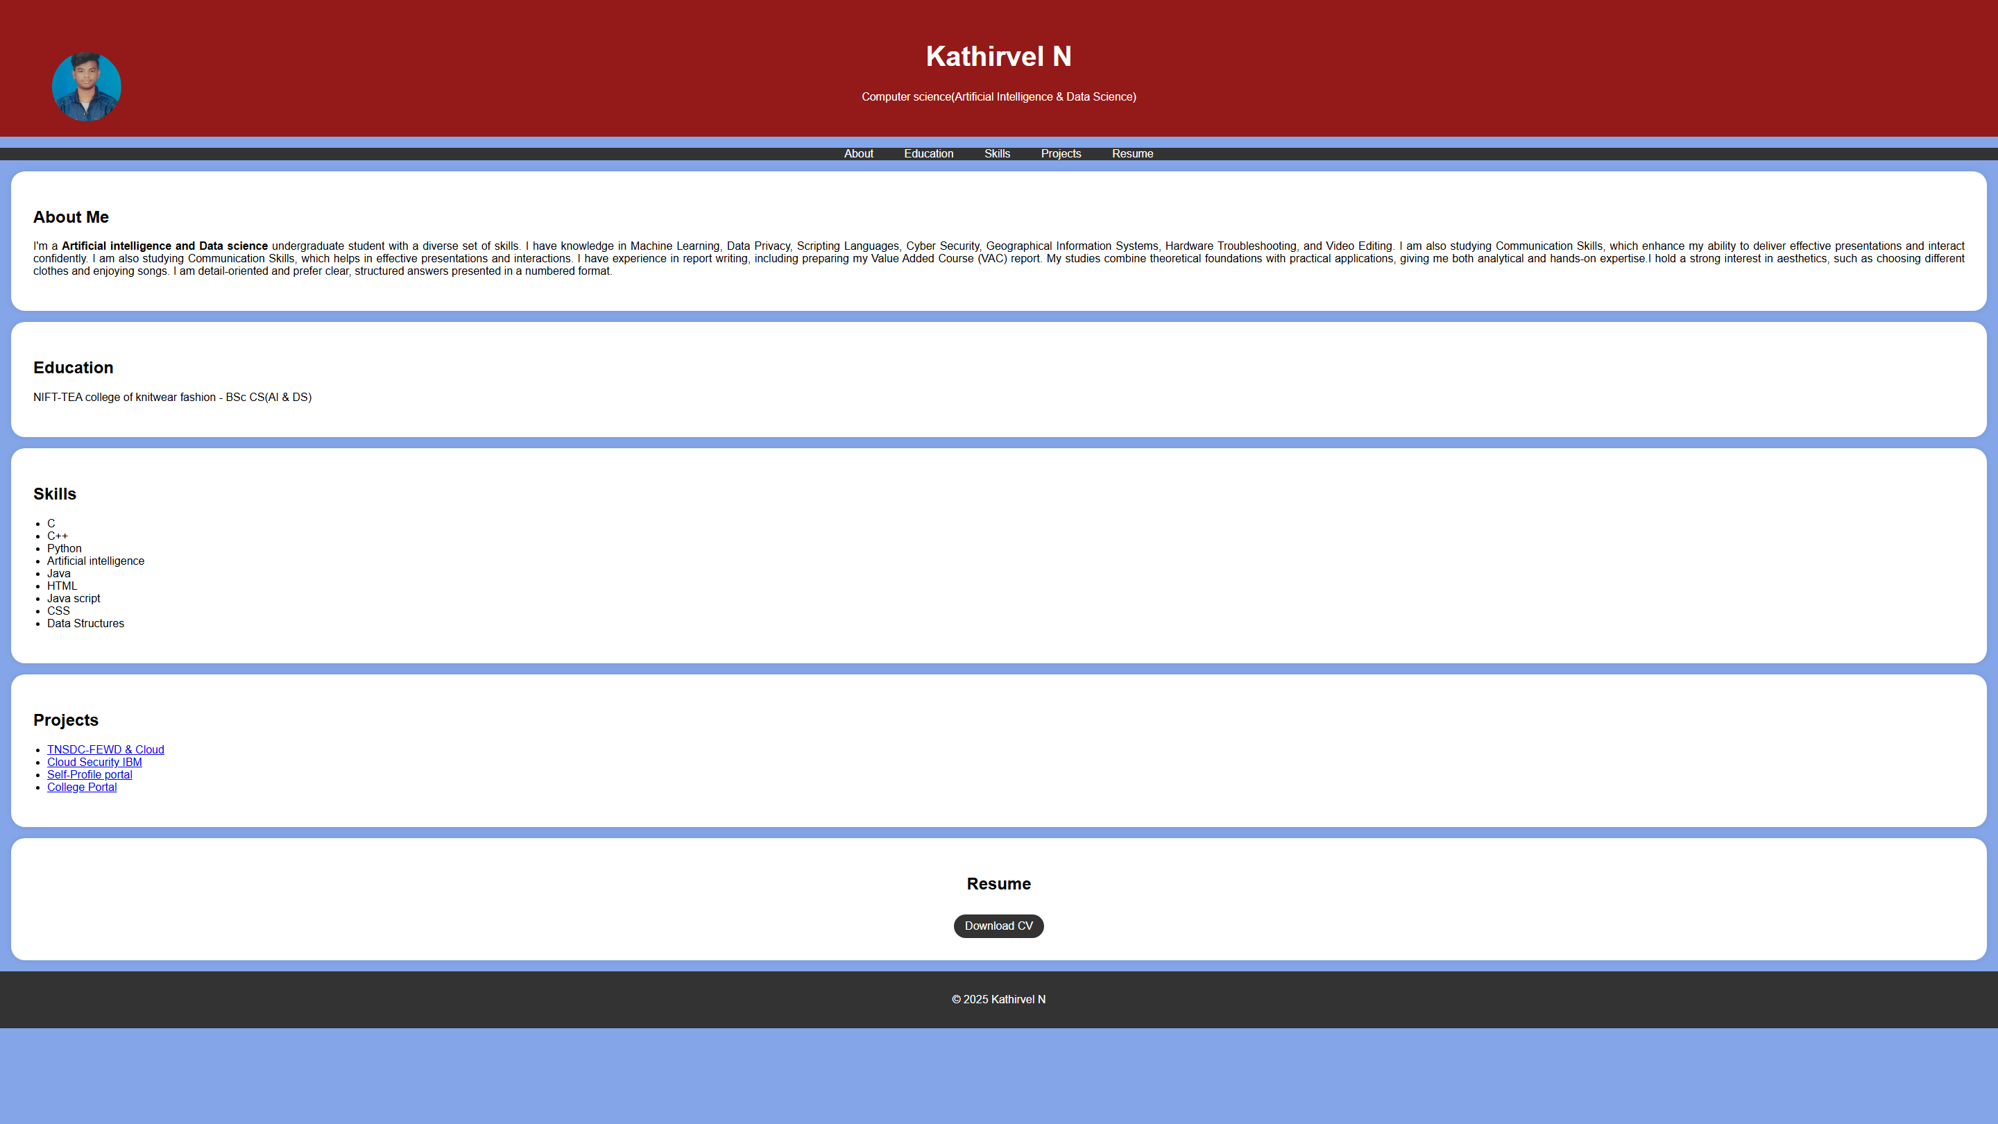

RESULTS AND SCREENSHOTS
10

Slide 11
CONCLUSION
The portfolio website is thoughtfully designed with both usability and professional presentation in mind. It successfully integrates essential features such as responsive design, resume details, skills showcase, education background, project highlights, and simple contact information.
The structured navigation bar and modern styling ensure that users can easily explore different sections, while the resume download option provides quick access to detailed credentials.
Overall, the website not only highlights academic achievements, technical skills, and projects but also delivers a clean, interactive, and easy-to-update platform that serves as a strong digital representation of the individual’s professional resume.
11

